Slide 1
Food bank and food store
Team Hungry Birds

Slide 2
Client name and organization
UVSS Food bank is a non-profit organization that provides free food and clothes for Uvic students in needs.

Slide 9
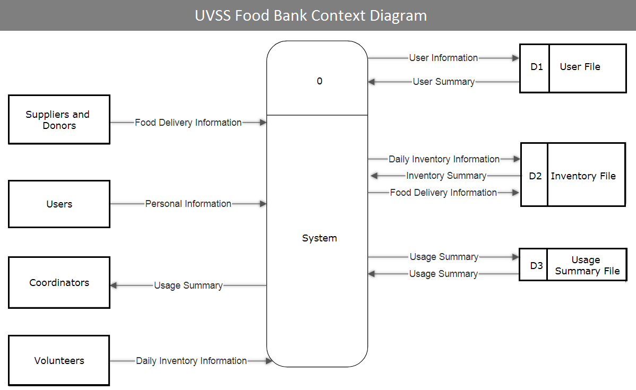
Context Diagram

Slide 10
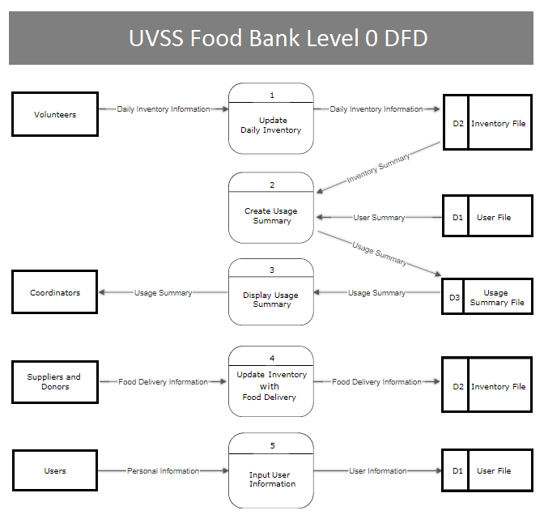
Level 0 Data flow diagram

